Slide 1
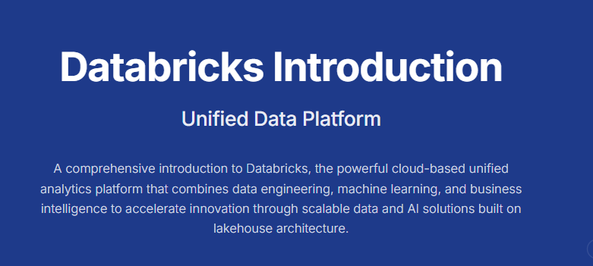

Slide 2
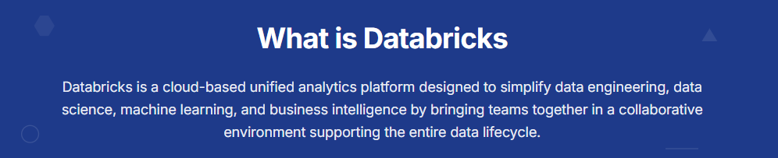

Slide 3
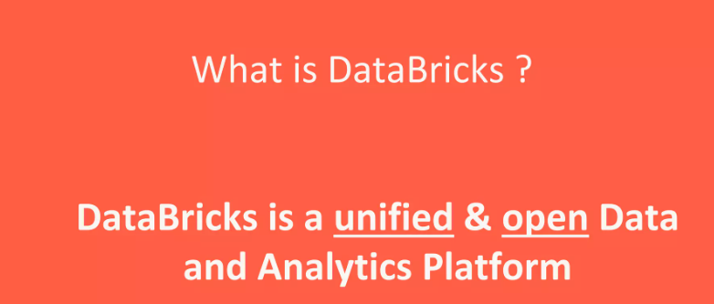

Slide 4
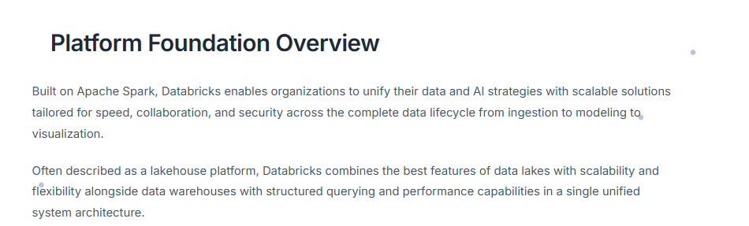

Slide 5
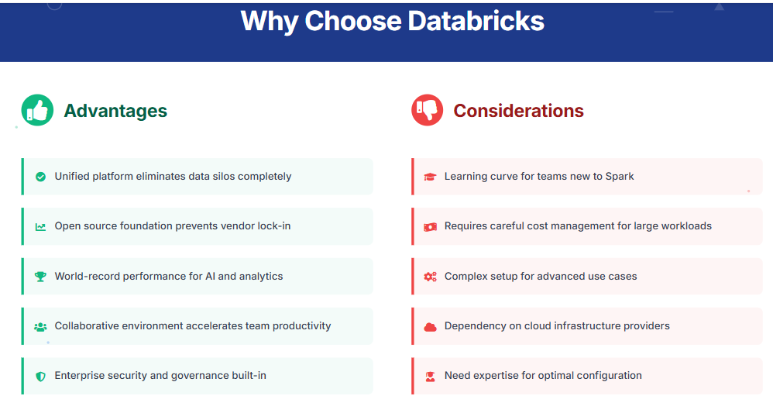

Slide 6
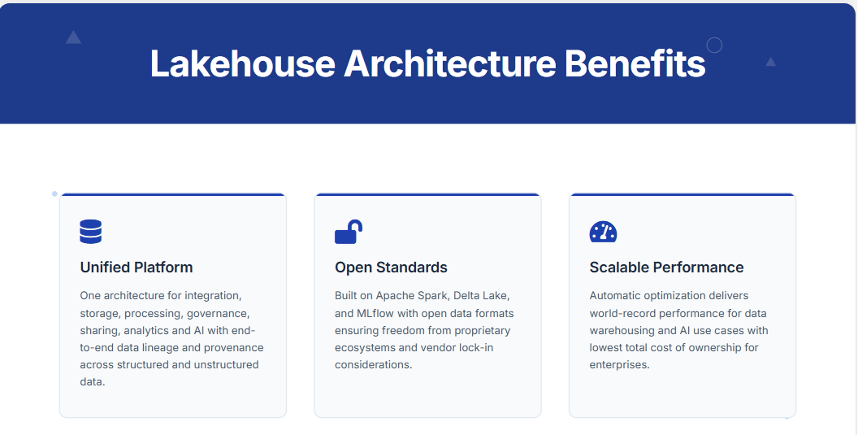

Slide 7
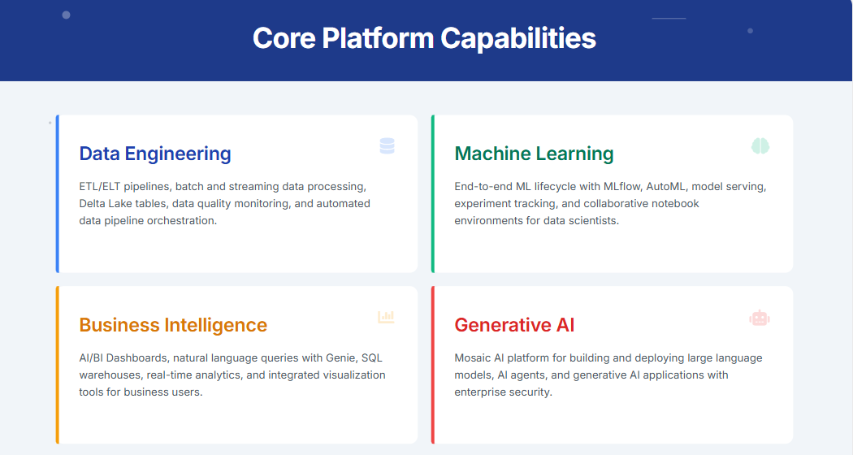

Slide 8
Key Characteristics of a Lakehouse:
Unified data storage for all types of data (structured, semi-structured, unstructured)
Support for ACID transactions
Schema enforcement and evolution
Robust governance and data security
High-performance SQL and BI support
Native support for machine learning and data science

Slide 9


Slide 10
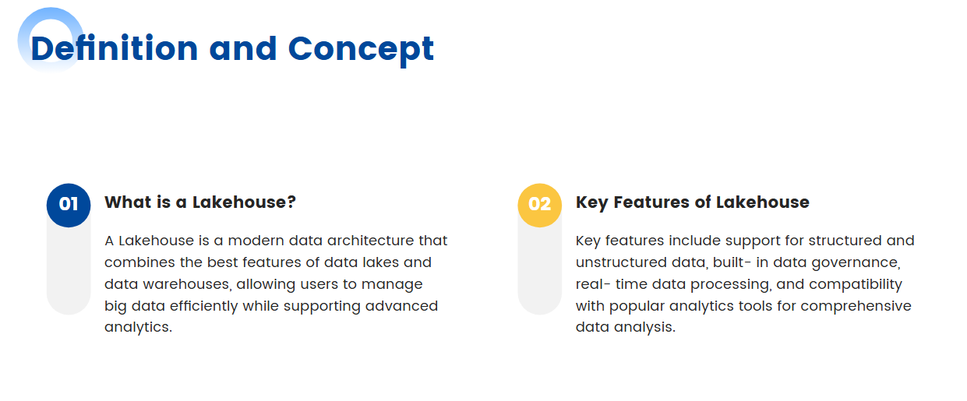

Slide 11
A Data Warehouse is optimized for structured data and BI workloads. It supports SQL out of the box, provides strong governance, and offers fast query performance. But it's not designed for unstructured data, real-time streaming, or ML pipelines. Scaling it is expensive, and schema changes are painful.
A Data Lake, on the other hand, sits on cheap object storage like S3 or ADLS. It handles structured, semi-structured, and unstructured data in its raw form. Ideal for storing logs, events, or raw ingest. But data lakes lack ACID transactions, schema enforcement, and consistent performance. Querying them often means building complex ETL pipelines or duplicating data into a warehouse.
This growing divide between scalability and structure led to a new architectural need, one that could deliver the flexibility of lakes and the reliability of warehouses.
The result was the Lakehouse, a unified approach that blends the best of both worlds without compromising on governance, performance, or openness.

Slide 12
What Makes a Lakehouse… a Lakehouse?
🗂️ Structured & Unstructured Data Support: Store everything from images to structured tables
⚙️ Delta Lake Format: ACID transactions, versioning, schema enforcement
🚀 Separation of Storage & Compute: Scale independently
🔍 Data Governance with Unity Catalog: Centralized metadata & access controls
🔄 Open Formats: Built on Apache Parquet, Delta Lake, open APIs

Slide 13
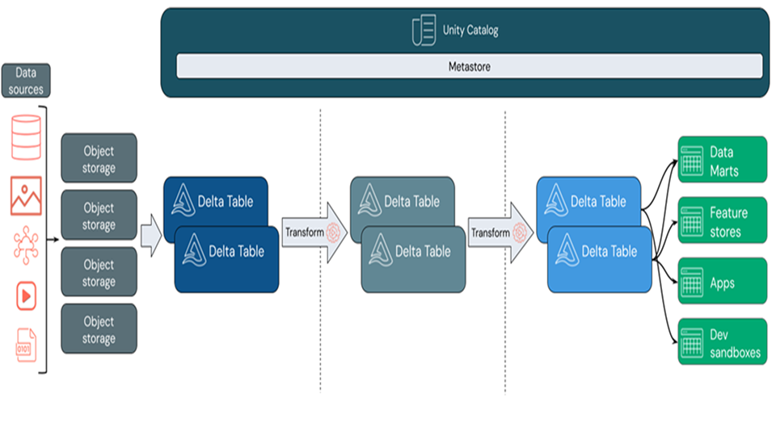
The Evolution from Warehouse and Data Lake

Slide 14
Scope of the Lakehouse: All-in-One Data Platform

Slide 15
A true Lakehouse supports end-to-end workflows across diverse data teams
🏗️ Data Engineering ETL, transformation pipelines, orchestration—powered by Delta Lake & DLT
🧪 Data Science & ML Native integration with MLflow, feature stores, and model tracking
📊 Business Intelligence & Reporting BI tools connect seamlessly—Power BI, Tableau, Looker
🌐 Streaming Analytics Real-time ingestion, processing, and dashboarding
🔒 Data Governance Centralized cataloging, policies, lineage (thanks to Unity Catalog)
🧠 Generative AI & LLMs Easily fine-tune and deploy models with the same trusted platform

Slide 16
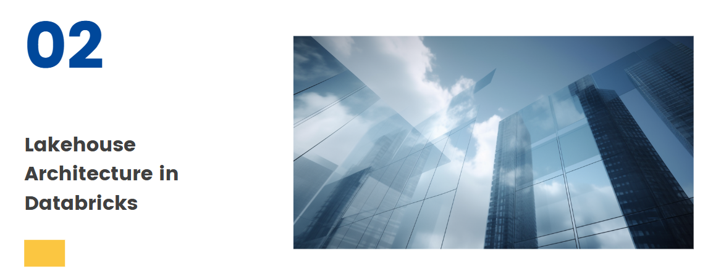

Slide 17
Databricks Lakehouse Platform is built on top of open-source technologies such as Apache Spark and Delta Lake. It’s designed to simplify data architecture by reducing the need for multiple tools across the data lifecycle.

Slide 18
Core Layers of the Lakehouse
The Lakehouse Architecture provides the scalability of data lakes with the performance and structure of warehouses, all while being cost-efficient, open, and AI-ready.
A Lakehouse is a new kind of data architecture that merges the low-cost storage and flexibility of a data lake with the ACID transactions and schema enforcement capabilities of a traditional data warehouse.
🧊 Data Lake: Raw, unstructured and semi-structured data ingestion
🪄 Delta Layer: Reliable data with ACID properties (via Delta Lake)
📊 Analytics Layer: BI-ready data with indexing and caching for fast performance
🧠 ML & AI: Native support for ML workflows, notebooks, and MLflow

Slide 19
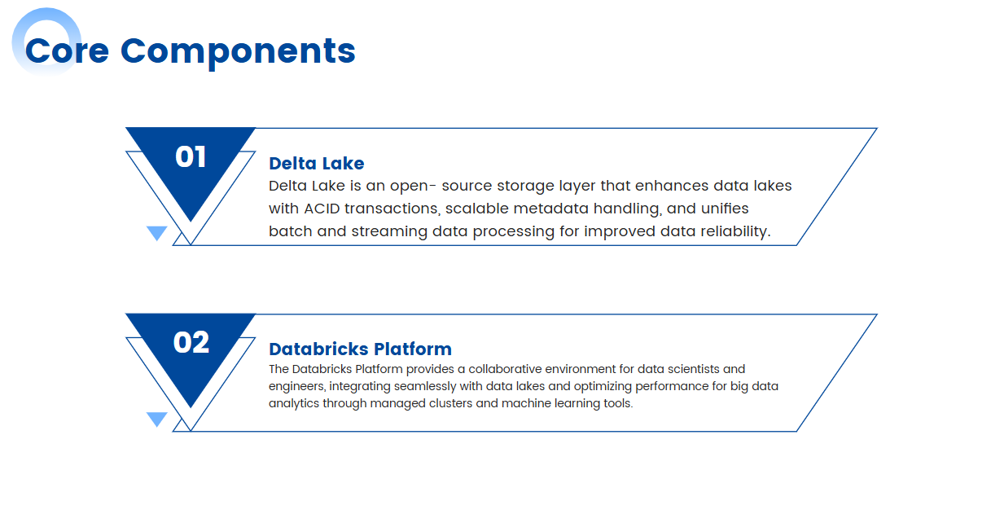

Slide 20
Core Components:
Delta Lake – The foundation of the Lakehouse
Apache Spark – For distributed data processing
MLflow – For managing the ML lifecycle
Databricks SQL – For analytics and business intelligence
Unity Catalog – Centralized governance and access control

Slide 21
1. Delta Lake: The Storage Layer Backbone
At the heart of the Databricks Lakehouse Architecture lies Delta Lake, an open-source storage layer that adds reliability, consistency, and performance to data lakes.
Features of Delta Lake:
ACID Transactions: Guarantees data integrity even in concurrent environments.
Time Travel: Access and revert to previous versions of data.
Schema Enforcement and Evolution: Ensures consistent and clean data.
Data Compaction: Optimizes storage by reducing small file overhead.
Use Case Example: A retail company tracks inventory updates in real-time. With Delta Lake, it can ensure accurate, deduplicated data regardless of how frequently updates are made.

Slide 22
2. Apache Spark: Scalable Data Processing Engine
Databricks builds upon Apache Spark, the leading open-source unified analytics engine for big data processing.
Why Apache Spark Matters:
Supports batch and real-time streaming data processing
Highly scalable and distributed
Compatible with multiple languages: Python, SQL, Scala, Java, R
Optimized for ML workloads and data transformation
Spark on Databricks is optimized to provide faster execution and better resource management, enabling teams to handle workloads ranging from small ad-hoc queries to enterprise-scale ETL.

Slide 23
3. MLflow: End-to-End ML Lifecycle Management
Data science teams need more than just data; they need tools for experiment tracking, model deployment, and reproducibility. This is where MLflow, an open-source ML lifecycle platform, comes in.
MLflow Capabilities:
Experiment Tracking: Logs model metrics, parameters, and artifacts.
Model Registry: Centralized hub for managing model versions.
Deployment: Easily deploy models into production across platforms.
Lakehouse Advantage: Data scientists can train models directly on high-quality, governed data in the lakehouse, eliminating the need to move data to separate ML environments.

Slide 24
4. Databricks SQL: Real-Time Analytics and BI
Databricks offers a SQL-native interface allowing business analysts to query data directly from the lakehouse using familiar SQL syntax.
Features of Databricks SQL:
Interactive dashboards and visualizations
Auto-scaling clusters for cost efficiency
Built-in query optimization with Photon engine
Integration with BI tools like Tableau, Power BI, and Looker
This capability democratizes data access, enabling analysts, data engineers, and scientists to collaborate seamlessly on a single source of truth.

Slide 25
5. Unity Catalog: Centralized Governance and Security
Data security and compliance are paramount for modern enterprises. Unity Catalog provides unified data governance across the entire Databricks workspace.
Governance Features:
Centralized metadata management
Fine-grained access controls
Audit logs for all data activity
Data lineage tracking
With Unity Catalog, organizations can meet regulatory requirements (like GDPR or HIPAA) while ensuring internal data standards are upheld.

Slide 26
Advantages of the Databricks Lakehouse Architecture
Unified Data Management
No need to maintain separate systems for analytics and machine learning—Databricks offers a single platform for all workloads.
Cost-Effective Scalability
Thanks to its cloud-native infrastructure and separation of storage and compute, Databricks provides elastic scaling, which helps reduce costs.
Improved Data Quality and Governance
With features like Delta Lake’s ACID compliance and Unity Catalog, data is both reliable and secure.
Simplified Data Pipelines
By centralizing data transformation, analytics, and ML on one platform, teams can build and iterate faster.

Slide 27
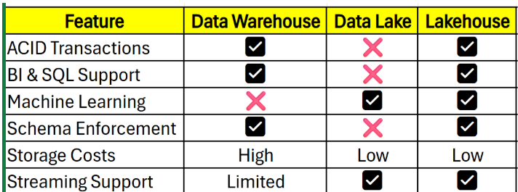
Databricks Lakehouse vs Traditional Architectures

Slide 28
Common Use Cases
1. Financial Services
Real-time fraud detection
Risk modeling
Regulatory compliance
2. Retail & E-commerce
Personalized recommendation systems
Inventory and supply chain analytics
Customer behavior analysis
3. Healthcare
Predictive analytics in patient care
Clinical trial data management
HIPAA-compliant data storage
4. Manufacturing
IoT sensor data aggregation
Predictive maintenance
Quality control analytics

Slide 29
Lakehouse Reference Architecture
Data Ingestion Layer
🌐 Supports batch and real-time pipelines
🔌 Connects to structured, semi-structured & unstructured sources (IoT, ERP, APIs)
🛠️ Tools: Auto Loader, Delta Live Tables, Partner tools like Fivetran or Informatica
2️⃣ Bronze-Silver-Gold Layering
🥉 Bronze: Raw ingested data, no transformations
🥈 Silver: Cleansed and conformed datasets
🥇 Gold: Aggregated business-level data for BI/ML
✅ Promotes quality, lineage, and trust step-by-step
3️⃣ Storage Layer – Delta Lake
💾 Built on open formats (Parquet + Delta)
🔁 Supports ACID transactions, schema evolution, and versioning
🔐 Ensures data reliability and consistency across workloads

Slide 30
4️⃣ Compute Layer
🔧 Unified engines (Databricks SQL, Spark, Photon)
🎯 Serve all personas: Data Engineers, Analysts, Scientists
☁️ Elastic scaling, job orchestration, and workload isolation
5️⃣ Governance & Security
🛡️ Unity Catalog provides centralized access control
🔍 Lineage, classifications, audits, and role-based policies
🔐 Seamless integration with IAM systems (Azure AD, Okta)
6️⃣ Data Access & Consumption
📊 Supports BI tools like Power BI, Tableau, Looker
📡 Exposes APIs for operationalization
🤖 Enables AI/ML integration via MLflow, Feature Store
Notes:
This reference architecture can be implemented in banking and telco sectors, where security, compliance, and scalability are non-negotiable

Slide 31
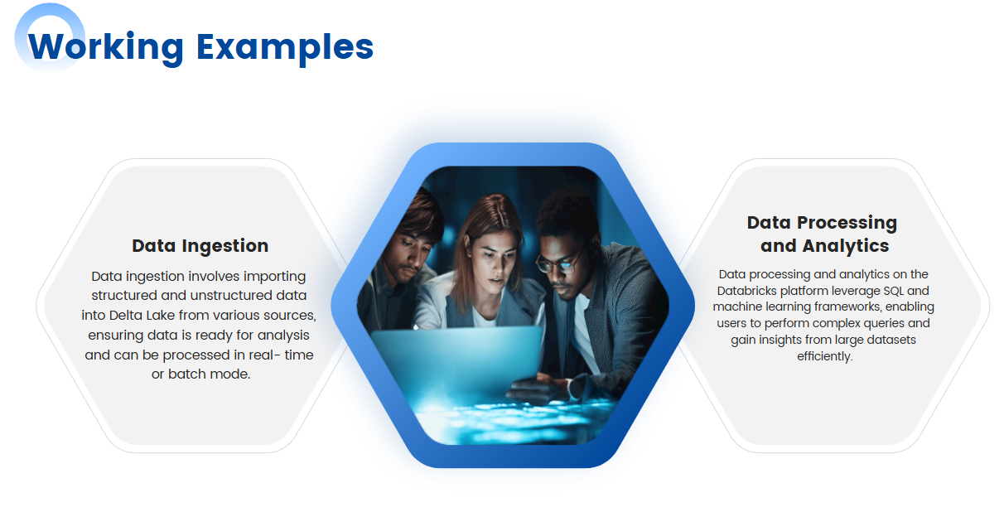

Slide 32
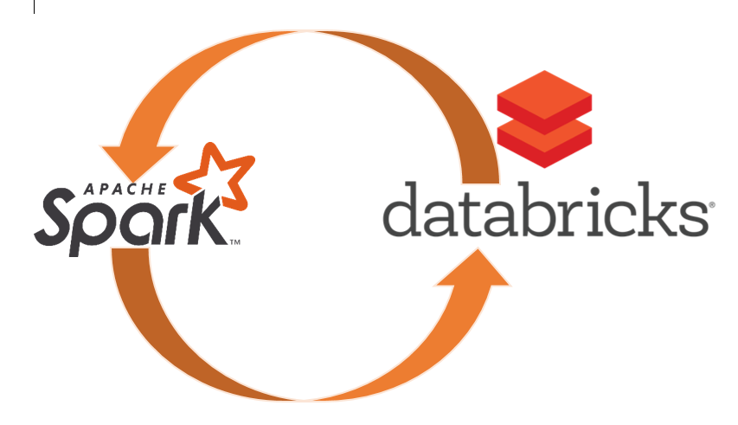

Slide 33
SPARK vs DATABRICKS
Apache Spark: The Basics Apache Spark is an open-source distributed computing system that provides an interface for programming entire clusters with implicit data parallelism and fault tolerance. It is designed to handle large-scale data processing and offers various built-in modules for streaming, SQL, machine learning, and graph processing.
Databricks: The Enhanced Experience Databricks, founded by the original creators of Apache Spark, is a cloud-based platform that offers a managed Spark service along with additional features designed to simplify and enhance the big data analytics workflow.

Slide 34
Key Comparisons and Advantages of Databricks:
1. Managed Service:
Apache Spark: Requires significant effort to set up, configure, and manage Spark clusters, including handling hardware provisioning, software configuration, and ongoing maintenance.
Databricks: Provides a fully managed service that automates cluster management, reducing operational complexity and freeing up time for data engineers and scientists to focus on their core tasks.
2. Optimized Performance:
Apache Spark: While powerful, performance tuning and optimization require in-depth knowledge and experience.
Databricks: Offers performance enhancements through features like optimized Spark engine, built-in caching, and auto-scaling, ensuring better performance out-of-the-box.
3. Integrated Workspace:
Apache Spark: Typically involves multiple tools for data storage, processing, and visualization, leading to fragmented workflows.
Databricks: Combines data engineering, data science, and machine learning in a single collaborative workspace, providing notebooks for interactive data analysis and seamless integration with various data sources.

Slide 35
Key Comparisons and Advantages of Databricks:
4. Advanced Security and Compliance:
Apache Spark: Requires manual setup and configuration for security, making it challenging to ensure comprehensive security and compliance.
Databricks: Provides enterprise-grade security features, including data encryption, role-based access control, and compliance with standards like GDPR and HIPAA, making it easier to meet regulatory requirements.
5. Collaborative Environment:
Apache Spark: Collaboration between team members can be challenging due to disparate tools and environments.
Databricks: Facilitates collaboration through shared notebooks, real-time co-authoring, and integrated version control, enabling teams to work together more effectively.
6. Seamless Integration with ML and AI Tools:
Apache Spark: While it supports machine learning through MLlib, integration with other ML and AI tools can require additional effort.
Databricks: Offers seamless integration with popular ML and AI frameworks like TensorFlow, PyTorch, and scikit-learn, along with built-in support for MLflow, streamlining the entire machine learning lifecycle from experimentation to production.

